Slide 1
虛擬化技術 Virtualization Technique
Hardware Support Virtualization
ARM’s Virtualization Extension

Slide 2
Agenda
Review on system virtualization
Definition of Virtual Machine Monitor
Problems when we try to implement VMM
Software solution
Hardware solution
Overview of ARM architecture
Brief introduction of ARM architecture
Security Extension
Virtualization Extension

Slide 3
Agenda
Support for CPU virtualization
Support for Sensitive Instruction
Native-run
Emulation support
Support for multiple Vector Table
Vector Table Base Address Registers
Hypervisor Call
New entry(0x14) on vector table

Slide 4
Agenda
Support for Memory virtualization
Intermediate Physical Address
VMID
Support for I/O virtualization
Virtual GIC
Case study: Citrix Xen for ARM Cortex-A15

Slide 5
Review on system virtualization

Slide 6
Definition of VMM
A virtual machine monitor can be constructed if the set of sensitive instructions is a subset of the set of privileged instructions
Proof shows
Equivalence
by interpreting privileged instructions and executing remaining instructions natively
Resource control
by having all instructions that change resources trap to the VMM
Efficiency
by executing all non-privileged instructions directly on hardware
A key aspect of the theorem is that it is easy to check

Slide 7
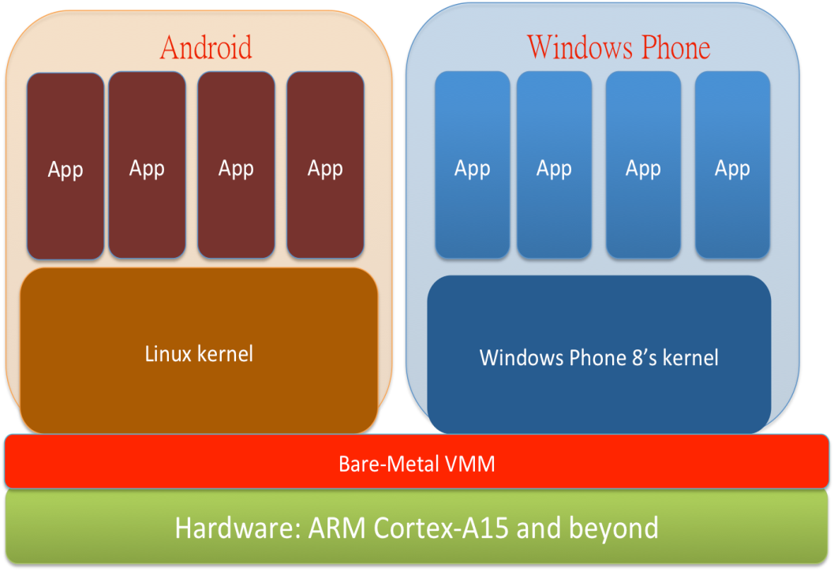
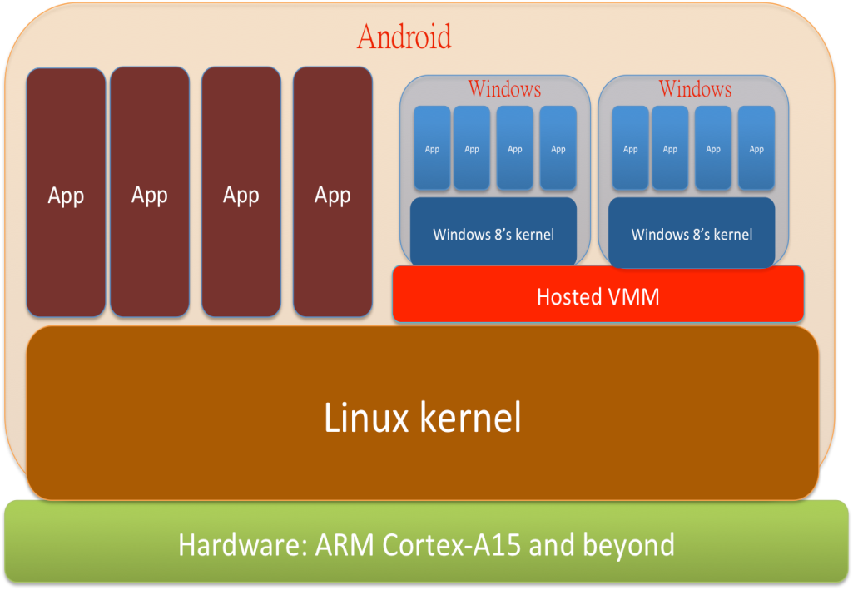
Implement models of VMM
Type-I
Type-II

Slide 8
Problems in implementation
CPU virtualization
Non-virtualizable CPU
Vector table issue
Memory virtualization
Translation from GVA to HPA
I/O virtualization
Emulate various I/O devices

Slide 9
Software Solution
CPU virtualization
Non-virtualizable CPU
→ Patch GOS / Dynamic Binary Translation
Vector table issue
→ Modify host’s VT to deliver interrupts to host or guests
Memory virtualization
Translation from GVA to HPA
→ Implement by software and save the translated result in Shadow Page Table
I/O virtualization
Emulate various I/O devices
→ Emulated by Software (like QEMU)

Slide 10
Disadvantage of software solution
CPU virtualization
Patch GOS
→ You need source code. It’s non-portable.
Dynamic Binary Translation
→ Slow down the performance on runtime
Vector table issue
→ Difficult to route interrupts to hypervisor and many GOSs
Memory virtualization
Translation from GVA to HPA
→ Waste time when generating to translation result
I/O virtualization
Emulate various I/O devices
→ Quite slow when emulating I/O devices
→ I/O devices are too diversity to cover all of them

Slide 11
Hardware solution
CPU virtualization
Non-virtualizable CPU
→ Let CPU become virtualizable
Vector table issue
→ With different registers for hypervisor and guest.
Memory virtualization
Translation from GVA to HPA
→ Translate VA-IPA-PA by MMU rather than software
I/O virtualization
Emulate various I/O devices
→ Directly I/O access

Slide 12
Overview OF ARM architecture

Slide 13
Brief introduction of ARM architecture

Slide 14
ARM architecture
ARM architecture is a well-known CPU architecture in embedded system, mobile devices, and low-power consumption devices.
Unlike other CPU venders, ARM doesn’t produce and ship their own chip. ARM license their IP to other SoC design house and let them to combine ARM CPU Core with their other chips.
ARM also allow SoC design house to change CPU’s ISA in their chips.

Slide 15
Roadmap of ARM’s CPUs
ARMv4
ARM7: Without MMU
ARMv5
ARM9: With MMU
ARMv6
ARM11: With MPCore support

Slide 16
Roadmap of ARM’s CPUs
ARMv7
With security extension, but without virtualization extension
Cortex-A8
Cortex-A9 / Cortex-A5
With security and virtualization extension, with LPAE
Cortex-A15 / Cortex-A7 (with big-LITTLE support)
ARMv8
64-bit support
Cortex-A57 / Cortex-A53 (aka. Cortex-A50 series)

Slide 17
Traditional ARM architecture
Privilege Level 0
Privilege Level 1
ARM 11 (ARMv6)

Slide 18
Traditional ARM architecture
Privilege Level 0:
User mode
Privilege Level 1:
System mode
IRQ mode
FIQ mode
Undefined mode
Supervisor mode
Abort mode

Slide 19
Overview : Security Extension

Slide 20
Security Extension
Security Extension, a.k.a. Trust-Zone, is a system-wide approach to security on high performance computing platforms for a huge array of applications including secure payment, digital rights management (DRM), enterprise and web-based services.
Security extension can make trusted application running on secure state and non-trusted application running on non-secure state.
When you are in the Non-Secure State, you cannot access the memory which is allocated for Secure State
It has been introduced since from ARM Cortex-A8

Slide 21
Security Extension
Non-Secure State
Secure State
Normal
App
Normal
App
Normal
App
Phone
SMS
Non-Secure OS
(ex: Linux)
Secure OS
(ex: RTOS)
Monitor
ARM Cortex-A8 and beyond

Slide 22
Privilege Level of Security Extension
Secured apps and secured OS runs on secure state
Monitor runs on monitor mode which is on Privilege Level 1 of Secure State(Secure State PL1).
Secured OS runs on Privilege Level 1 of Secure State(Secure State PL1).
Secured apps run on Privilege Level 0 of Secure State(Secure State PL0).

Slide 23
Privilege Level of Security Extension
Normal apps and normal OS runs on non-secure state
Normal apps(e.g. Angry-Bird, Browser, …) run on Privilege Level 0 of Non-Secure State(Non-Secure PL0).
Normal OS(e.g. Linux) runs on Privilege Level 1 of Non-Secure State(Non-Secure PL1).

Slide 24
Privilege Level of Security Extension
[Note] Privilege Level in ARM architecture
In ARM architecture, when the number of privilege level is higher means that it has more privilege to access hardware resource.

Slide 25
Privilege Level of Security Extension
Non-Secure State
Secure State
Privilege Level 0 of Non-Secure State
Privilege Level 0 of Secure State
Privilege Level 1 of Non-Secure State
Privilege Level 1 of Secure State
Monitor mode
ARM Cortex-A8 and beyond

Slide 26
Overview : Virtualization Extension

Slide 27
Virtualization Extension
Virtualization extension is the hardware support for virtualization on ARM architecture.
From ARM Cortex-A15 and beyond, ARM architectures are including virtualization extension.
We can consider that virtualization extension extends security extension for virtualization.
Virtualization extension includes three major parts:
CPU virtualization extension
Memory virtualization extension
I/O virtualization extension

Slide 28
Virtualization Extension
In CPU virtualization extension, ARM adds a new mode and a new Privilege Level. It calls “Hyp mode” which is running on Non-Secure Privilege Level 2.
In Memory virtualization extension, ARM adds “Intermediate Physical Address”, let Guest OS cannot access physical address directly.
In I/O virtualization extension, ARM adds “Virtual Generic Interrupt Controller” interface to deliver interrupt in more faster way.

Slide 29
Privilege Level of Virtualization Extension
Non-Secure State
Secure State
Privilege Level 0 of Non-Secure State
Privilege Level 0 of Secure State
Privilege Level 1 of Non-Secure State
Privilege Level 1 of Secure State
Privilege Level 2 of Non-Secure State
Monitor mode
ARM Cortex-A15 and beyond

Slide 30
Support for Cpu virtualization
Support for Sensitive Instruction
Support for multiple Vector table
Hypervisor call

Slide 31
CPU virtualization extension
It lets Guest OS run on Non-Secure Privilege Level 1 and Non-Secure Privilege Level 0.
Kernel of Guest OS runs on Non-Secure PL1.
Userspace of Guest OS runs on Non-Secure PL0.
It allows that most of (not all of them)sensitive instructions can native-run on Non-Secure PL1 without trap-and-emulation.
There are still some of sensitive instruction which need “trap-and-emulation”. When these instructions execute on Non-Secure PL1, it will be trapped into Hyp mode(in Non-Secure PL2).

Slide 32
Privilege Level of Virtualization Extension
Non-Secure State
Secure State
Privilege Level 0 of Non-Secure State
Privilege Level 0 of Secure State
Privilege Level 1 of Non-Secure State
Privilege Level 1 of Secure State
Privilege Level 2 of Non-Secure State
Monitor mode
ARM Cortex-A15

Slide 33
CPU virtualization
Non-Secure State
Secure State
App
App
App
App
App
App
RT App
RT App
PL0
Guest OS 1
Guest OS 2
RTOS
PL1
PL2
Hypervisor
Monitor mode
ARM Cortex-A15

Slide 34
Hyp mode
There is only one mode in Non-Secure Privilege Level 2.
That is Hyp mode
Hyp mode has its own SP, SPSR, ELR register
Most of critical feature of hardware-assistant CPU virtualization is executed in Hyp mode.

Slide 35
Hyp mode
Reference：” ARM® Architecture Reference Manual ARMv7-A and ARMv7-R edition ” page: B1-1139

Slide 36
Hyp mode
Hyp mode is off in default. If Hyp mode is off, all virtualization extension will be set off.
If you want to open Hyp mode, you have to use secure software(ex: Bootloader) running on secure state turn the Hyp mode on.

Slide 37
Hyp mode is different with x86’s VT-x
In VT-x of x86 architecture, “root-mode” is orthogonal to x86 rings.
However, in ARM’s virtualization extension, Hyp mode is one mode of all modes in ARM architecture.
ARM’s hyp mode is strictly more privileged than the existing kernel modes. ARM requires the hypervisor to save guest register state, while on x86 this is done automatically by hardware.
Ref: Prashant Varanasi, Gernot Heiser, “Hardware-Supported Virtualization on ARM”, APSys 2011

Slide 38
Instruction emulation
There are still some instructions which cannot execute natively.
Guest OS’s Load/Store PTR
The instruction’s behavior will effect other Guest OS
In virtualization extension, they will be trapped into hypervisor automatically when you execute these instructions on Non-Secure Privilege Level 1
There is NO necessary to patch guest OS for adding hypercall before executing a critical instructions because it will be trapped by hardware automatically.

Slide 39
Instruction emulation
When some instruction is trapped to Hyp mode, the hardware will also preserve some information on “Hypervisor Syndrome Register”(HSR) which is also a part of virtualization extension PTR
With the help of HSR, the hypervisor can know the entry reason and emulate it.
In the past, hypervisor still need these information. In order to get these information, hypervisor designer have to some software way to get these information.
With the assistance from hardware, hypervisor can get these information more easier and more faster.

Slide 40
Support for Cpu virtualization
Support for Sensitive Instruction
Support for multiple Vector table
Hypervisor call

Slide 41
Vector table for Monitor mode
In Security Extension, ARM provides two vector table. One of them is the original one. Another one is provided for the monitor mode.
The base address of monitor mode’s vector table is saved in MVBAR(Monitor Vector Base Address Register)
Only accessible in Monitor mode
When booting, software have to set Monitor mode’s vector table in Monitor mode.

Slide 42
Vector table for Hyp mode
In Virtualization Extension, ARM provides different vector table for Hypervisor.
The base address of Hyp mode’s vector table is saved in HVBAR(Hypervisor Vector Base Address Register)
Only accessible in Monitor mode and Hyp mode
When booting, software have to set Hyp mode’s vector table in Monitor mode.

Slide 43
Vector table for Guest OSes
In Virtualization Extension, ARM provides a register to save the vector table base address of Guest OS(which is running on Non-Secure PL0/1).
The base address of Non-Secure PL0/1’s vector table is saved in VBAR(Vector Base Address Register)
VBAR saves the base address of Non-Secure PL0/1’s vector table.

Slide 44
Overview of Vector Tables of all modes
Non-Secure State
Secure State
Privilege Level 0 of Non-Secure State
Privilege Level 0 of Secure State
VT for Non-Secure PL0&1
VT for Secure PL0&1
Privilege Level 1 of Non-Secure State
Privilege Level 1 of Secure State
Hyp mode
VT for Hyp mode
Mon mode
VT for Mon. mode
ARM Cortex-A15

Slide 45
Support for Cpu virtualization
Support for Sensitive Instruction
Support for multiple Vector table
Hypervisor call

Slide 46
Background: SVC for normal OS
Before we introduce Hypervisor Call(HVC), we should recall some knowledge about Supervisor Call(SVC) in normal OS.
In previous microarchitecture version of ARM, it is called Software Interrupt(SWI).
Supervisor Call is a instruction which can trigger a software interrupt. If the program execute “svc” in the user space (Privilege Level 0), the processor will move into the vector stub of SVC which is in the kernel space
SVC is a way to actively trigger event to enter the supervisor mode from user mode.

Slide 47
How does SVC work?

Slide 48
Virtual Memory Address
CPU mode:
Supervisor Mode
svc_handler:
…
…
…
Kernel
Space
Vector
Table
b svc_handler
User
Space
CPU mode:
User Mode
…
svc #0x190
…
PC

Slide 49
What is HVC?
HVC, a.k.a. Hypervisor Call, is a instruction which will actively trigger event to enter Hyp mode(Non-Secure PL2) from Guest OS(Non-Secure PL1).
The relationship between Guest OS and Hypervisor in HVC is the same as the relationship between User-space and Kernel-space in SVC.
In vector table, the interrupt from HVC will be taken into the 0x14 vector stub.
With the help of HVC, hypervisor designer can be easily to implement “Hypercall”

Slide 50
Vector stub of HVC
Vector Table without virtualization extension
Vector Table with virtualization extension
0x1C | FIQ
0x18 | IRQ
0x14 | (Reserved, Not used)
0x10 | Data Abort
0x0C | Prefetch Abort
0x08 | Supervisor Call
0x04 | Undefined Instruction
0x00 | Reset
0x1C | FIQ
0x18 | IRQ
0x14 | Hypervisor Call
0x10 | Data Abort
0x0C | Prefetch Abort
0x08 | Supervisor Call
0x04 | Undefined Instruction
0x00 | Reset

Slide 51
How does HVC work?

Slide 52
Memory
CPU mode:
NS PL2
hvc_handler:
…
…
…
Hypervisor
Vector
Table
b hvc_handler
Guest OS
CPU PL:
NS PL1
…
hvc #0x190
…
PC

Slide 53
Support for Memory virtualization
Intermediate Physical Address
VMID

Slide 54
Translation Regime
Recall that
Host OS & guest OS’s execute in non-secure PL1&0.
Hypervisor runs in non-secure PL2
Other RTOS’s run in secure mode.
Different software reference different page tables, and there are corresponding MMU to manage the translation process.
This design can separate different translation request handling process. Requests from guest OS must be intercept by VMM, and requests form hypervisor itself could be handled in the original way.

Slide 55
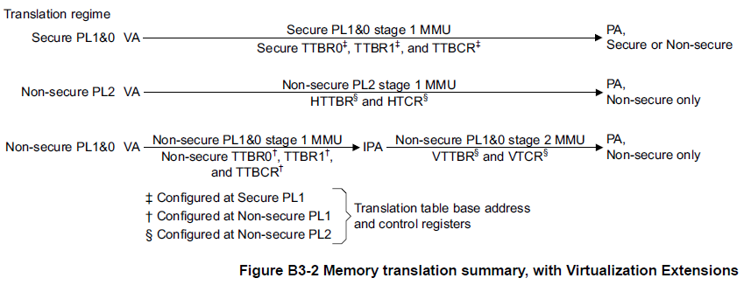
Memory Translation on ARMv7

Slide 56
What is IPA?
Intermediate physical address
IPA is the output of the stage 1 translation, and is also the input of the stage 2 translation
Stage 1 maps the Virtual Address (VA) to an Intermediate Physical Address (IPA).
Typically, the Guest OS configures and controls this stage, and believes that the IPA is the Physical Address (PA)
Stage 2 maps the IPA to the Physical Address(PA).
Typically, the hypervisor controls this stage, and a Guest OS is completely unaware of this translation.
VMM take whole control at this stage.

Slide 57
How VA-IPA-PA works?
If the translation regime only provides one stage translation regime, then IPA is equal to physical address.
Stage 1 translation must be in 64-bits format.
LPAE (Large Physical Address Extension)

Slide 58
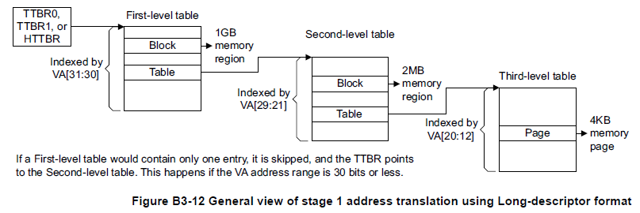
How VA-IPA-PA works?
Stage 1
The input address range is 32 bits
The out put address range is 40 bits. (1TB)
With virtualization extension, the output is IPA; otherwise, it’s PA.

Slide 59
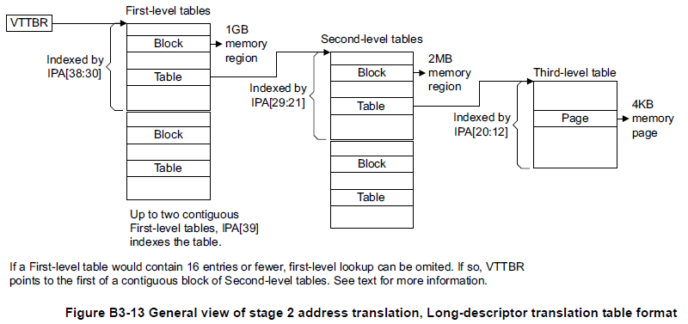
How VA-IPA-PA works?
Stage 2
Supported only if virtualization extension is included.
The input address range must be 40 bits.
The output address range is up to 40 bits.

Slide 60
Large Physical Address Extension
64-bit descriptor entries
Up to three levels of address lookup.
Input addresses of up to 40 bits, when used for stage 2 translations.
Output addresses of up to 40 bits.
4KB assignment granularity across the entire PA range.
No support for domains, all memory regions are treated as in a Client domain.
64-bit table entries.
Fixed 4KB table size, unless truncated by the size of the input address space.

Slide 61
Support for Memory virtualization
Intermediate Physical Address
VMID

Slide 62
What is VMID?
Virtual machine identifier
identifies the current virtual machine, with its own independent ASID space.
ASID (address space identifier): part of TLB maintenance.
With ASID, TLB could identify entries belong to different process
Only used in LPAE.
When to use VMID
The TLB entries include this VMID information, meaning TLBs do not require explicit invalidation when changing from one virtual machine to another, if the virtual machines have different VMIDs.
For stage 2 translations, all translations are associated with the current VMID, and there is no concept of global entries.

Slide 63

How VMID works?
When a translation walk is requested, the VMID will be checked to make sure the PTB, which VTTBR points to, is correct.
VTTBR
Virtual translation table base register
64 bits with 8-bit VMID

Slide 64
Support for I/O virtualization
Virtual GIC

Slide 65
Background: GIC
GIC, a.k.a. Generic Interrupt Controller, is the only one interrupt controller in ARM architecture.
There is a firmware, called “Interrupt Distributor”.
In Interrupt Distributor, it save the information that which kinds of interrupt should be routed into which kind of state.
Interrupt distributor should be setting in booting time. Then, we don’t need to take care about GIC.
In next slide, we will show you that how it works.

Slide 66
GIC
Distributor
CPU
Non-Secure
State
CPU Interface
Secure
State

Slide 67
Virtual Interrupt
In software solution of system virtualization, I/O device emulation is always heavyweight.
In order to avoid emulation of I/O device, ARM provide virtual interrupt with the help of new hardware component, the virtual CPU interface.
Using these hardware support, it can let guest to acknowledge and clear interrupts without trapping into the hypervisor.
Ref: Prashant Varanasi, Gernot Heiser, “Hardware-Supported Virtualization on ARM”, APSys 2011

Slide 68
Virtual Interrupt Distributor
The hypervisor must still emulate the interrupt distributor; all guest accesses to it trap.
This is not expected to cause performance issues, as the distributor is normally only accessed at boot time to register drivers for particular interrupts and route them to specific (virtual) CPUs.
Ref: Prashant Varanasi, Gernot Heiser, “Hardware-Supported Virtualization on ARM”, APSys 2011

Slide 69
Virtual Interrupt Distributor
Virtual Interrupt Distributor’s job is the category the interrupt group. Choose which kinds of interrupt should be routed to hypervisor’s vector table and which kinds of interrupt should be routed to Guest OS’s vector table.
ARM provides “Virtual CPU interface” in GIC to help hypervisor designer to implement Virtual Interrupt Distributor.

Slide 70
Virtual Interrupt Distributor
Once hypervisor’s “Virtual Interrupt Distributor” has set the interrupt controller in booting time. When interrupt occurs in running time, the interrupt which is categorized as “Direct route to GOS” will directly be routed to Guest OS’s vector table and handle by Guest OS without the help of hypervisor.
Only the interrupt which is categorized as “Need to route to hypervisor” will be routed to hypervisor’s vector table and handle by hypervisor.

Slide 71
Booting time
SETUP
GIC
Distributor
CPU
Hypervisor
CPU Interface
Virtual Distributor
Virtual CPU
Interface
Emulate
GOS
GOS
Secure

Slide 72
Interrupt
Running time
GIC
Distributor
CPU
Hypervisor
CPU Interface
Virtual Distributor
Virtual CPU
Interface
GOS
GOS
Secure

Slide 73
SMMU
ARM will support I/O virtualization via a system MMU (SMMU) similar to the IOMMU on x86, but this is a platform feature, and ARM has to date only released their extensions to the core ISA.
Ref: Prashant Varanasi, Gernot Heiser, “Hardware-Supported Virtualization on ARM”, APSys 2011
Ref: CoreLink system controllers for AMBA. http://www.arm.com/products/system-ip/controllers/index.php, 2011.

Slide 74
Case study
Citrix Xen for ARM Cortex-A15

Slide 75
Review: Xen on x86
Xen is a Type-I hypervisor. Xen directly runs above hardware. And the guests of Xen are run above Xen.
The guest OSs run above Xen have different privilege level.
Dom0: Have higher privilege.
DomU: Other guest OS. Have lower privilege
Xen support full-virtualized guest OS and para-virtualized guest OS.
Full virtualized GOS is called as HVM
Para virtualized GOS is called as PV

Slide 76
Review: Xen’s architecture (PV)

Slide 77
Review: Xen’s architecture (HVM)

Slide 78
Design goal of ARM version
PV one GOS for all physical machine
Use PV interface for I/O
Rearchitected for the modern age
No more QEMU
No Shadow Page Table

Slide 79
CPU virtualization
Run most of instructions natively
Only emulate some instructions in hypervisor
Same entry point on native and on Xen
Use HVC to implement hypervisor call in PV guest

Slide 80
Memory virtualization
Use two layer translation (VA-IPA-PA)
Remove SPT related codes:
10,721 lines of code have been removed
Use VMID to separate different VM’s memory
In HVM guest only
No PV MMU calls

Slide 81
I/O virtualization
Use virtual GIC to support I/O virtualization
In PV Guest
No emulated device
Use Para-virtualization interface for I/O
In HVM Guest
Use device tree to discover Xen presence
Remove useless device in Xen’s device tree
Simple device emulation can be done in Xen

Slide 82
Device tree of Xen

Slide 83
References
Paper resources :
Prashant Varanasi, Gernot Heiser, “Hardware-Supported Virtualization on ARM”, APSys 2011
Web resources:
ARM Trust-Zone http://www.arm.com/products/processors/technologies/trustzone.php
ARM Virtualization Extension http://www.arm.com/products/processors/technologies/virtualization-extensions.php
Hardware accelerated Virtualization in the ARM Cortex Processors http://xen.org/files/xensummit_seoul11/nov2/2_XSAsia11_JGoodacre_HW_accelerated_virtualization_in_the_ARM_Cortex_processors.pdf
Linaro connect : Introduction to Xen on ARM http://www.slideshare.net/xen_com_mgr/linaro-connect-xen-on-arm-update
Xen ARM with Virtualization Extensions http://wiki.xen.org/wiki/Xen_ARMv7_with_Virtualization_Extensions
Architecture manual resources:
“ ARM® Architecture Reference Manual ARMv7-A and ARMv7-R edition”, ARM Limited. , 2011
“ARM® Generic Interrupt Controller Architecture version 2.0 Architecture Specification”, ARM Limited, 2011

